Slide 1
Chapter – 4
Carbon and its compounds
- Important Carbon Compounds
- Soap and Detergents

Slide 2
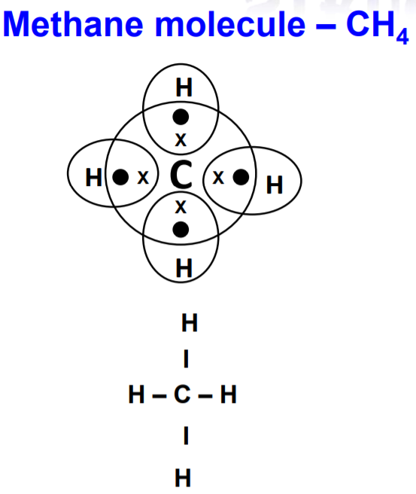
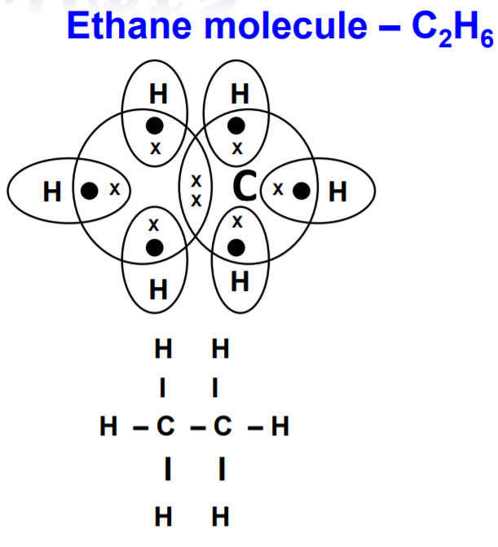
Electron Dot Structure
Notes:
Ethanol is considered as the most important organic compound.
Molecular formula of ethanol is C2H6.
Methane is a simplest of the saturated hydrocarbons with a chemical formula CH₄.
It consists of four hydrogen atoms and one carbon atom and is the simplest alkane.

Slide 3
Uses of Methanol and Ethanol
Methanol (CH₃OH) and ethanol (C₂H₅OH) are the simplest members.
Of the primary alcohol family and have a wide range of applications in the fuel industry.
Some important uses of methanol and ethanol are listed in this article.
Ethanol is also used as an antiseptic and as a disinfectant.
In cases of ethylene glycol poisoning or methyl alcohol poisoning, ethanol is often administered as an antidote.
Notes:
Uses of Ethanol -
Ethanol is widely used as a fuel additive and as an engine fuel.
Some forms of gasoline are known to contain up to 25% ethanol.
This compound has also been used as rocket fuel in some bipropellant rockets.
When used in fuel, ethanol is believed to reduce carbon monoxide and nitrogen oxide emissions.
Uses of methanol-
It is used as antifreeze, solvent, fuel, and as a denaturant for ethanol.
The chemical is also used to produce biodiesel via transesterification reaction.
Because methanol has toxic properties, it is frequently used as a denaturant additive for ethanol manufactured for industrial purposes.

Slide 4
Characterstics of Hydrocarbon
Factors that determine the properties of a hydrocarbon are:
The number of carbon atoms How the atoms are arranged:
1. Straight chain
2. Branched chain
3. Ring Or Cyclic

Slide 5
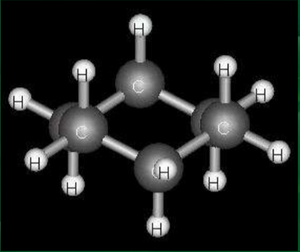
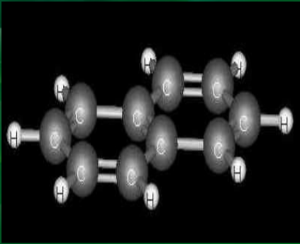
Types of Hydrocarbon
SATURATED HYDROCARBON UNSATURATED HYDROCARBON
Notes:
Saturated hydrocarbons in which all hydrogen atoms and carbon atoms are bonded together with single bonds.
Unsaturated hydrocarbons have double or even triple bonds between the carbon atoms.

Slide 6
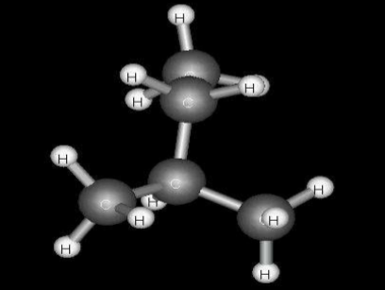
Saturated Hydrocarbon
A Hydrocarbon is an organic compound that contains only the elements hydrogen and carbon. In a saturated hydrocarbon, all the bonds are single bonds. Alkane is another name for a saturated hydrocarbon.

Slide 7
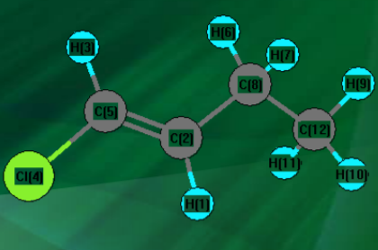
Unsaturated Hydrocarbon
A Hydrocarbon that considers one or more double and triple bonds in an unsaturated hydrocarbon.
There are three type of Unsaturated Hydrocarbons: alkenes, alkynes and aromatic hydrocarbons.

Slide 8
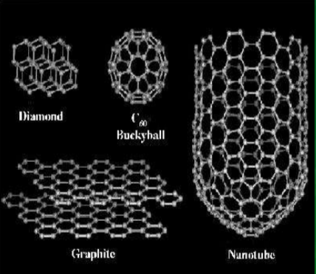
Allotropes of Carbon
Allotropy or allotropism is the property of some chemical elements to exist in two or more different forms, known as allotropes of these elements. Allotropes are different structural modifications of an element; the element's atoms are bonded together in a different manner. For Example –
Diamond
Graphite
Fullerene
Notes:
Diamond - Diamond is a well-known allotrope of carbon that exhibits hardness and high dispersion of light.
Graphite - Graphite is another allotrope of carbon; unlike diamond, it is an electrical conductor and a semi-metal.
Fullerence - Fullerenes (also called buckyballs) are molecules of varying sizes composed entirely of carbon that take on the form of hollow spheres, ellipsoids, or tubes.

Slide 9
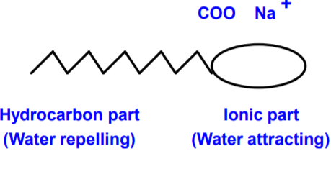
Soaps And Detergents
Soaps :- Soaps are long chain sodium or potassium salts of carboxylic acids.
Eg:- Sodium stearate – C17H35COONa.
Structure of soap molecule :- A soap molecule has two parts.
A long hydrocarbon part which is hydrophobic (water repelling).
Soluble in oil and grease and a short ionic part which is hydrophyllic (water attracting).
Insoluble in oil and grease.
Notes:
Soap and detergent, substances that, when dissolved in water, possess the ability to remove dirt from surfaces such as the human skin, textiles, and other solids.

Slide 10
Soap Action
Cleansing action of soap :- When soap is dissolved in water it forms spherical structures called micelles.
In each micelle the soap molecules are arranged radially such that the HC part is towards the center and the ionic part is towards the outside.
The HC part dissolves the dirt, oil and grease and forms an emulsion at the center of the micelles which can be washed away by water.

Slide 11
Notes:
(IT’S A GIF..)
In each micelle the soap molecules are arranged radially such that the HC part is towards the center and the ionic part is towards the outside.
The HC part dissolves the dirt, oil and grease and forms an emulsion at the center of the micelles which can be washed away by water.

Slide 12
Detergents
Detergents are long chain sodium salts of sulphonic acids.
Soaps do not wash well with hard water-
Because it forms insoluble precipitates of calcium and magnesium salts in hard water.
Detergents wash well with hard water-
Because it does not form insoluble precipitates of calcium and magnesium salts in hard water.

Slide 13
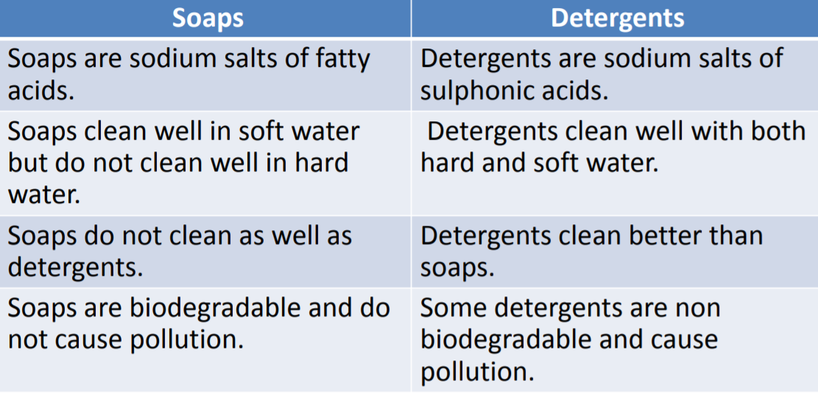

Slide 14

Thank You

